Slide 1
Cash Management
Presented by [Name]

Slide 2
Cash
Cash Cash is the lifeblood of every business.
Cash is the most liquid current asset a firm can hold.
Efficient cash management helps the company to remain healthy and strong.
Poor cash management, may end up pushing the company to a crisis.

Slide 3
Why does a firm need cash?
Speculative motive – hold cash to take advantage of unexpected opportunities
Precautionary motive – hold cash in case of emergencies
Transaction motive – hold cash to pay the day-to-day bills
While cash serves these functions, it is an idle resource which has an opportunity cost.
The liquidity provided by cash holding is at the expense of profits sacrificed by foregoing alternative investment opportunities.

Slide 4
Cash Management
Cash management is the process that involves collecting and managing cash flows from the operating, investing, and financing activities of a company.
In business, it is a key aspect of an organization’s financial stability.

Slide 5
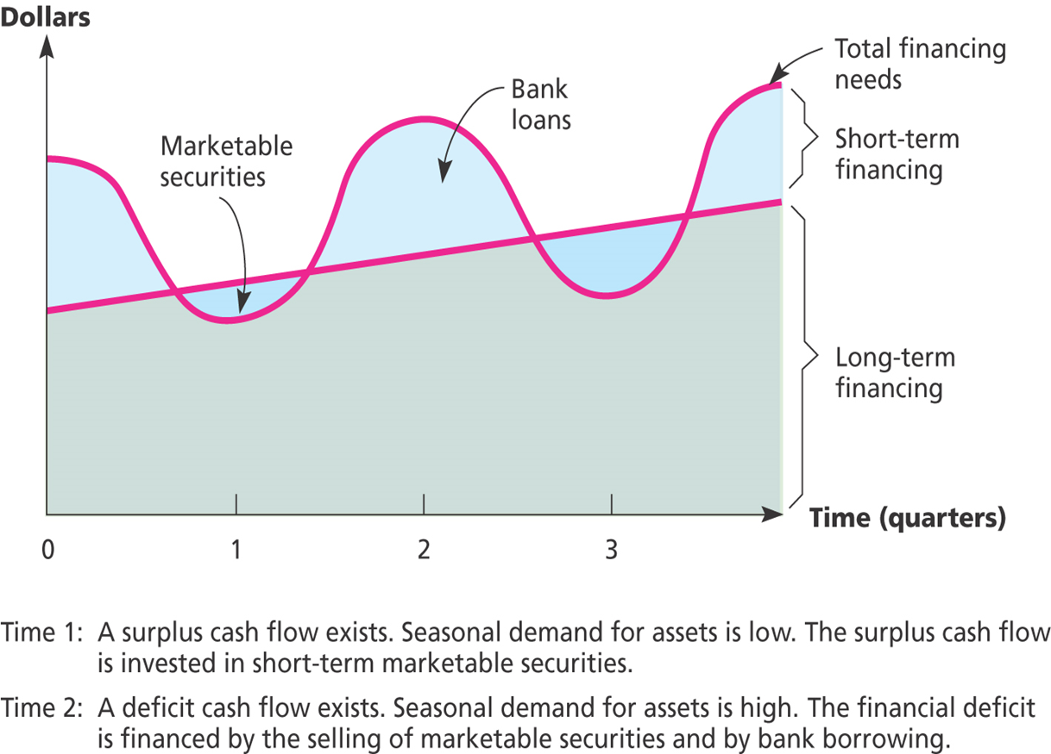
Conti…

Slide 6
Cash Management
Finance Manager Should
establish reliable forecasting and reporting Systems
improve cash collections and disbursements, and
achieve optimal conservation and utilisation of funds.

Slide 7
Cash budgeting or short-term cash forecasting
A cash budget is a document produced to help a business manage their cash flow. A cash budget is prepared in advance and shows all the planned monthly cash incomings (receipts) and any planned cash outgoings (payments).
Cash budgets, routinely prepared by business firms, are helpful in:
estimating cash requirements
planning short-term financing
scheduling payments in connection with capital expenditure projects
planning purchases of materials
developing credit policies,

Slide 8
Receipts and Payments Method
The cash budget prepared under this method shows the timing and magnitude of expected cash receipts and payments over the forecast period.
It includes all expected receipts and payments irrespective of how they are classified in accounting

Slide 9
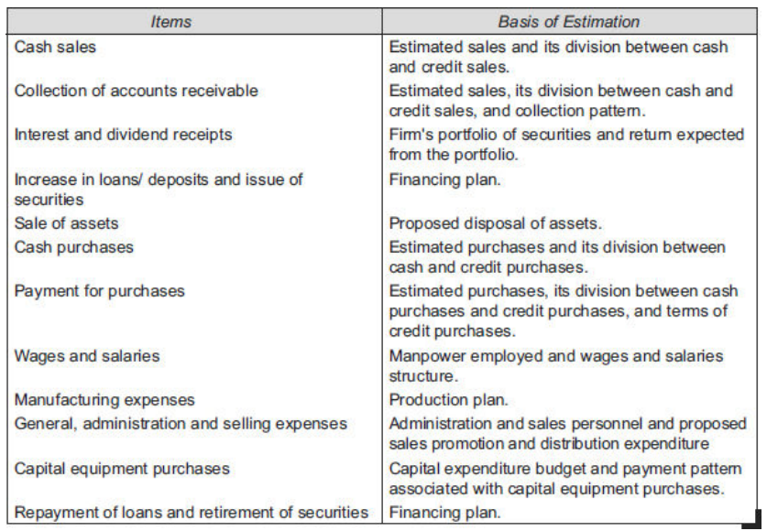
Items of Cash Receipts and Payments and the Basis of Their Estimation

Slide 10
Format of Cash Budget
CASH BUDGET
Particulars | April | May | June
Opening Cash Balance | X | X | X
RECEIPTS:
cash sales | X | X | X
credit sales | X | X | X
A) TOTAL RECEIPTS
PAYMENTS:
Material | X | X | X
Wages | X | X | X
Variable o/h | X | X | X
Fixed o/h | X | X | X
Income tax paid | X | X | X
Bonus paid | X | X | X
B) TOTAL PAYMENTS | X | X | X
A - B (Closing Cash Balance) | X | X | X

Slide 11
Cash Management Models
Several cash management models have addressed this issue of split between marketable securities and cash holdings. In this section we will discuss two of these models:
the Baumol model
the Miller and Orr model.

Slide 12
Baumol Model
William J. Baumol proposed a model which applies the economic order quantity (EOQ) concept, commonly used in inventory management, to determine the cash conversion size.
The model helps in determining the cash conversion size which means how much cash should be arranged by selling marketable securities in each transaction.

Slide 13
Conti….
This model assumes that cash can be arranged through selling marketable securities which the firms hold in the time of needs.
There are two types of cost involved in holding cash.
Opportunity cost
Transaction cost also known as conversion cost
The purpose of the model to minimise the total cost of cash holding which is summation of opportunity cost and transaction cost

Slide 14
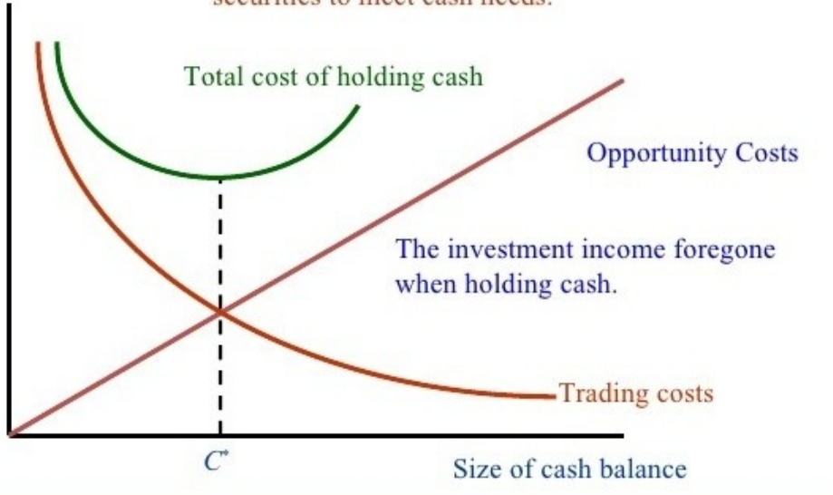

Slide 15
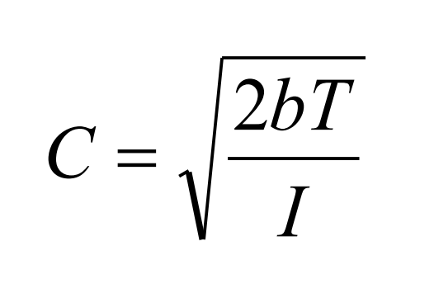
C = amount of marketable securities converted into cash per transaction (Economic cash holding size)
I = interest rate earned per planning period on investment in marketable securities
T = projected cash requirements during the planning period • b = conversion cost per transaction

